Slide 1
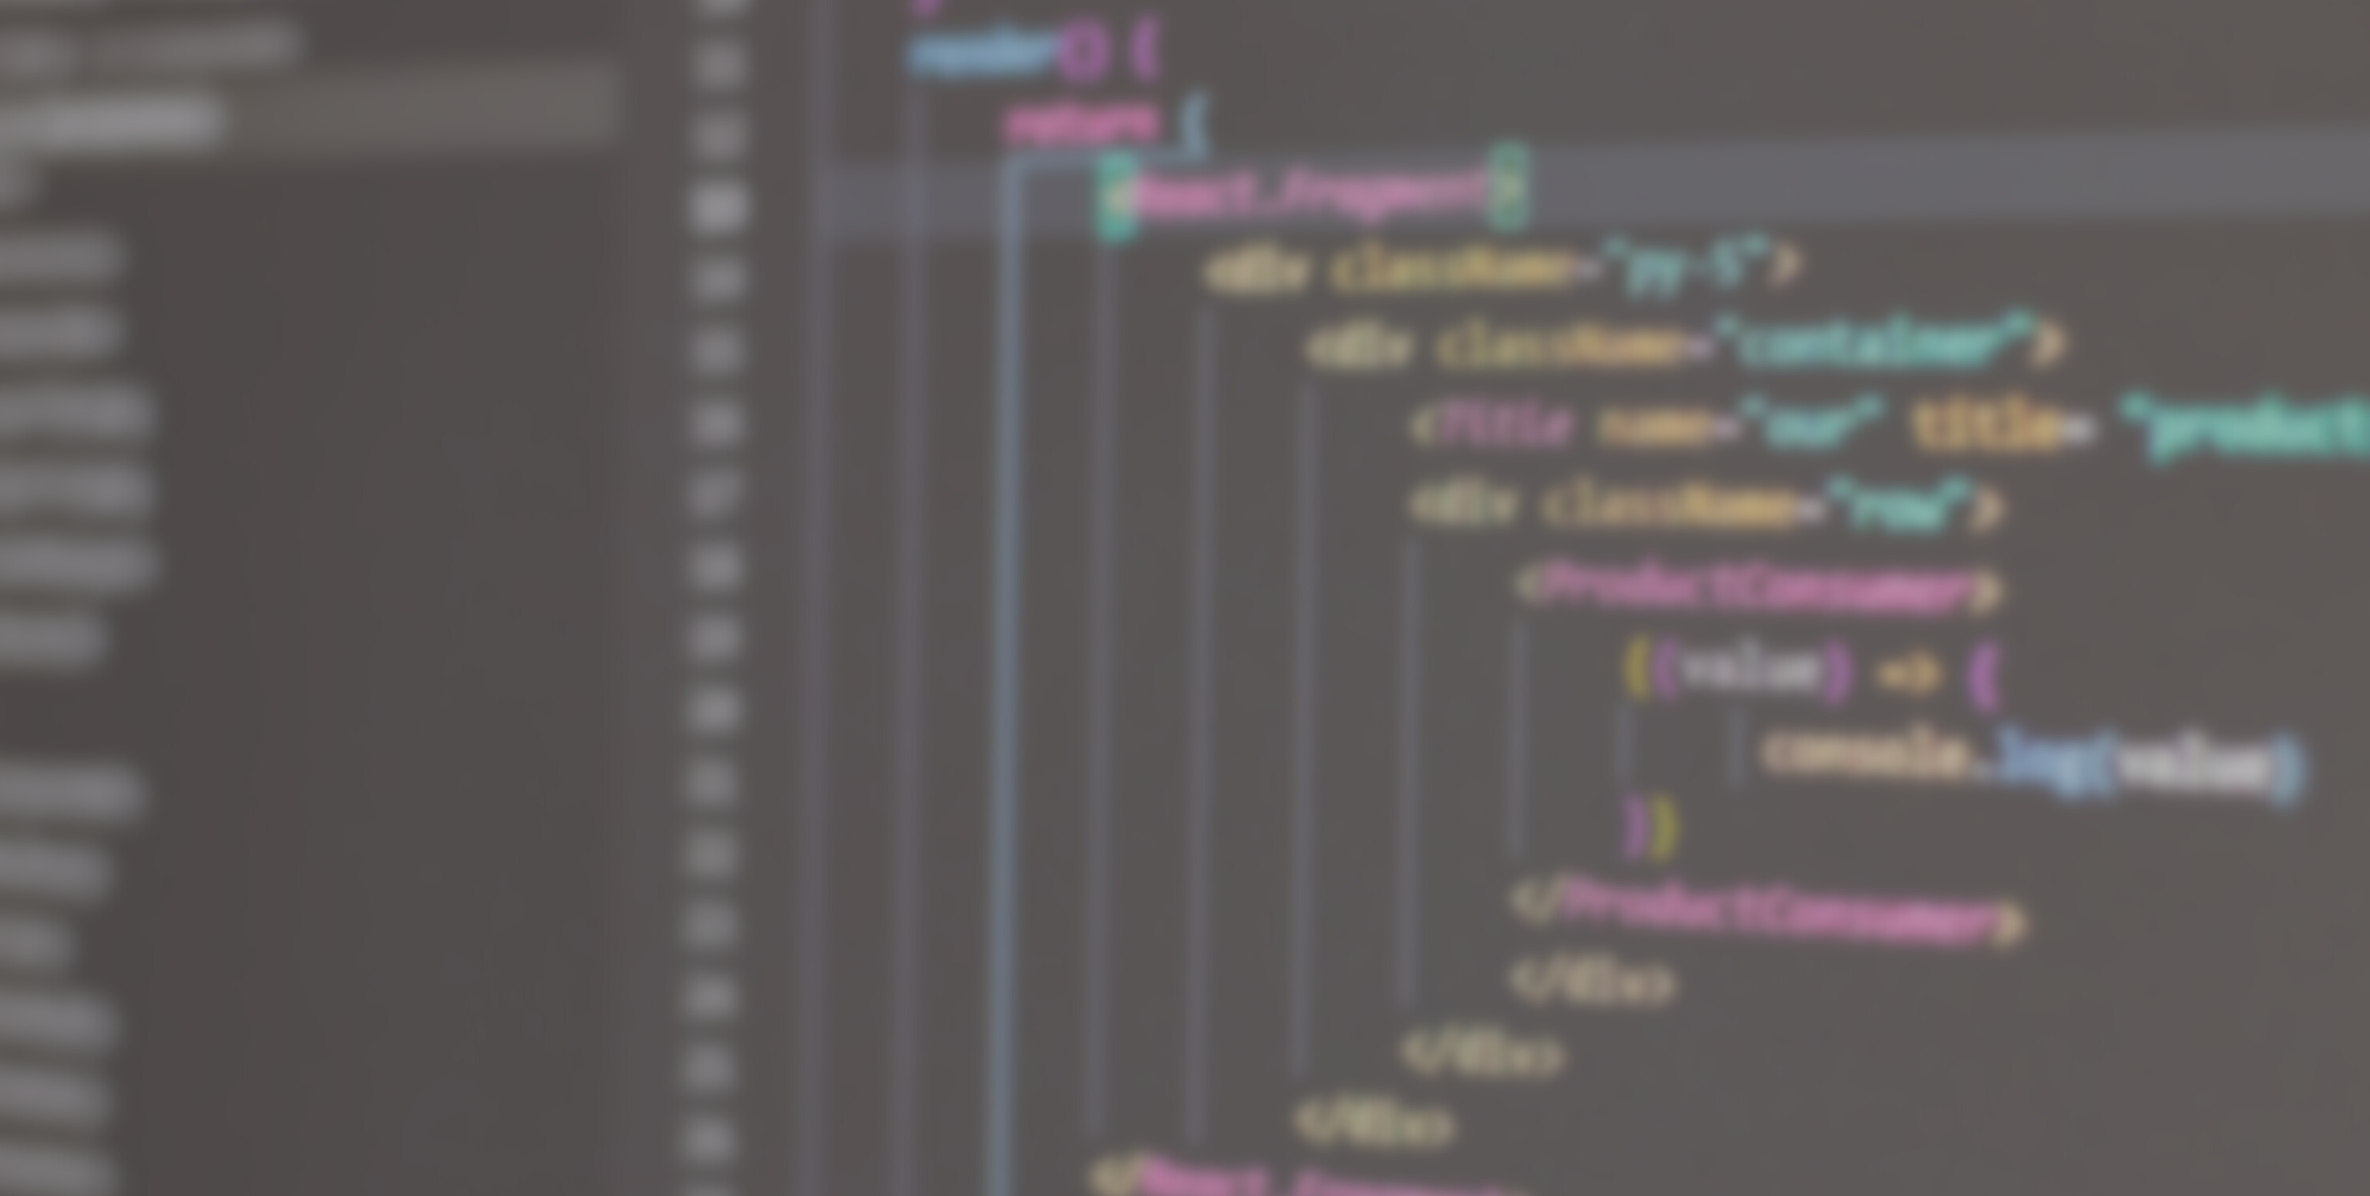
JAVA STAck DEVELOPER
April 2022
PORTOFOLIO
PORTOFOLIO
SANJANA SALIAN
Portofolio

Slide 2
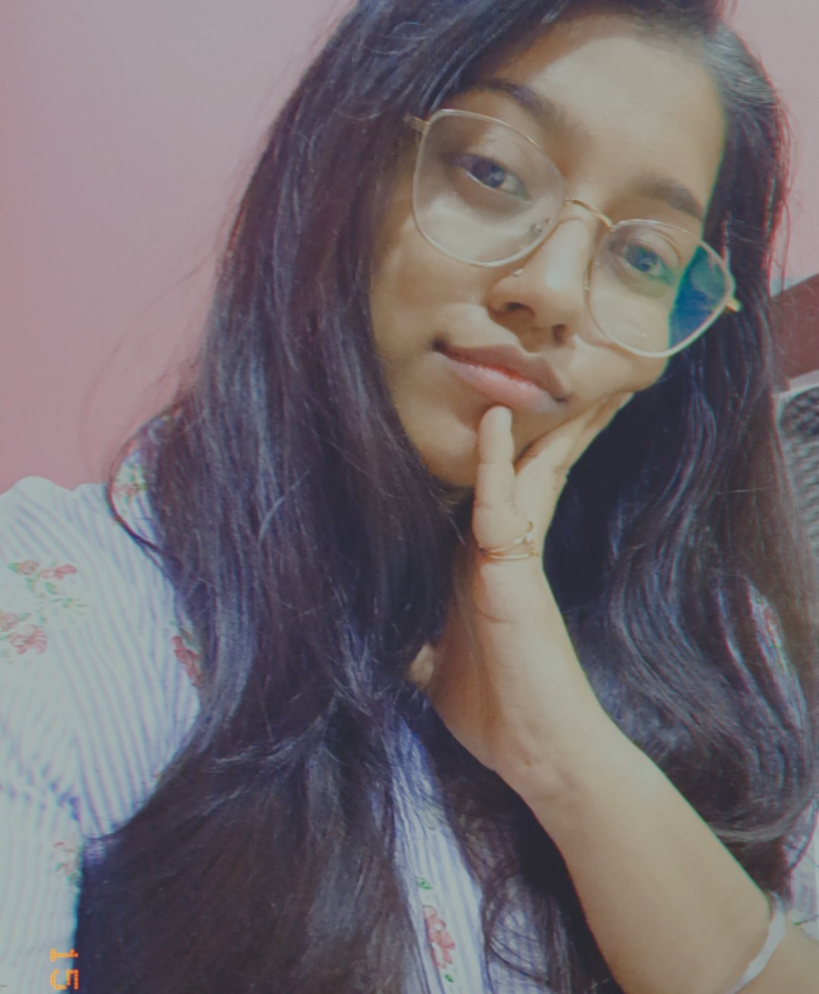
ABOUT ME
Sanjana
Salian
PORTOFOLIO
Welcome to my personal profile. I am a Full Stack Java Developer with a passion for web development and coffee! Ever Since I was a little kid, I loved understanding how things actually worked like the internal process of how everything worked. Learning how to program has given me a huge spectrum of understanding about how things work.

Slide 3

Projects

Slide 4
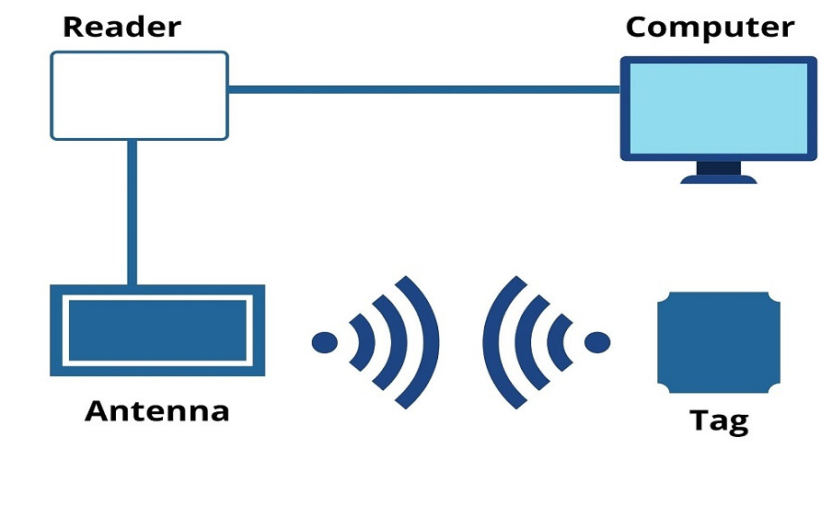
An embedded system wherein all the purchased product of the customer is calculated using RFID technology in Iot.
Using iot created a rfid based shopping cart

Slide 5

My Dream Car
Its website and app carry rich automotive content such as expert reviews, detailed specs and prices, comparisons as well as videos and pictures of all car brands and models available in India. Our vision is to construct a complete ecosystem for consumers and car manufacturers, dealers and related businesses such that consumers have easy and complete access to not only buying and selling cars, but also manage their entire ownership experience, be it accessories, tyres, batteries, insurance or roadside assistance.

Slide 6

A facile dance academy website built using HTML, CSS, JAVASCRIPT & PHP.
DaNCE ACADEMY WEBSITE

Slide 7

EXPERIENCE

Slide 8





JAVA: 5 years
HTML: 9 years
CSS: 9 years
BOOTSTRAP: 2 months
JAVASCRIPT : 9 years

Slide 9





PYTHON : 4 years
SQL : 5 years
C++: 9 years
REACT: 3 months
NODE : 3 months

Slide 10

EDUCATION

Slide 11
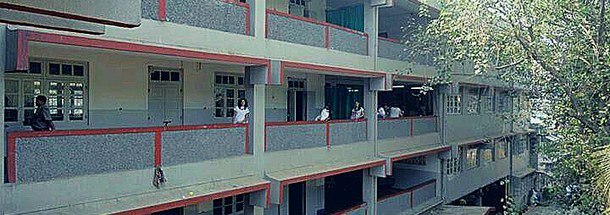

St.joseph Convent High SchooL
Obtained 76 Percentage
House Captain for 5 years
HOD of the Eco-club

Slide 12
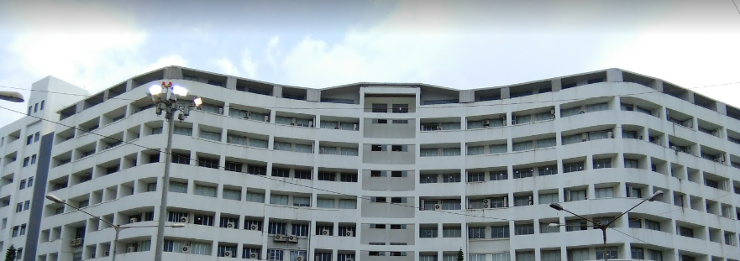

USHA PRAVIN GANDHI COLLEGE OF ARTS, SCIENCE & COMMMERCE
6.0 G.P.A
HOD of Sports Comittee
College President
Completed Green Computing Course.

Slide 13

PORTFOLIO
CONTACTS
SANJANA SALIAN
E-MAIL ID:
sanjanasalian1210@gmail.com
CONTACT NUMBER:
8850542251
GITHUB:
https://github.com/Breezy0
LINKEDIN:
https://www.linkedin.com/in/sanjana-salian-393617209/

